Slide 1
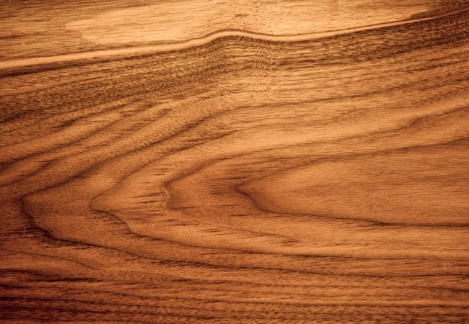
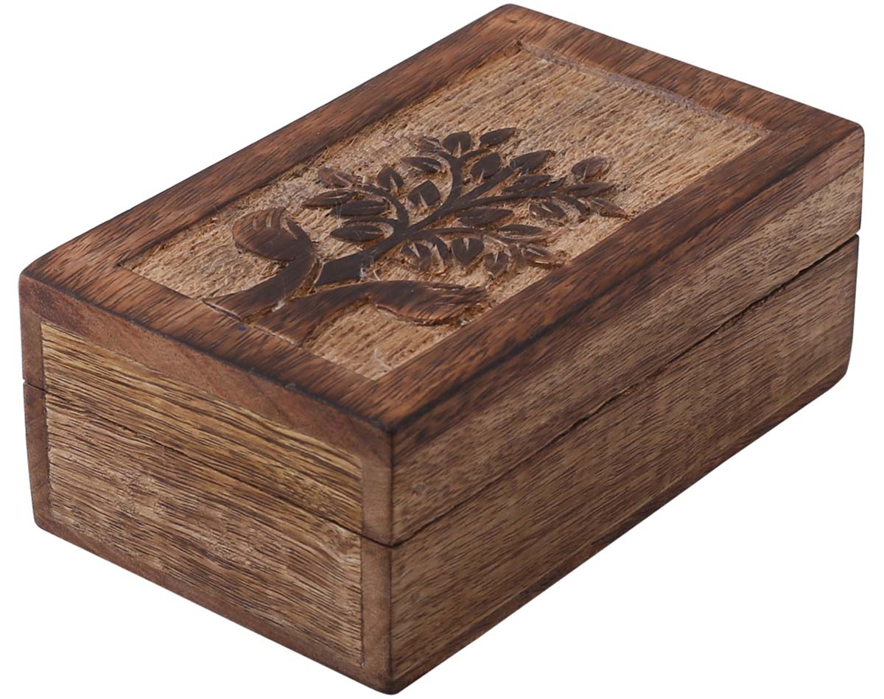
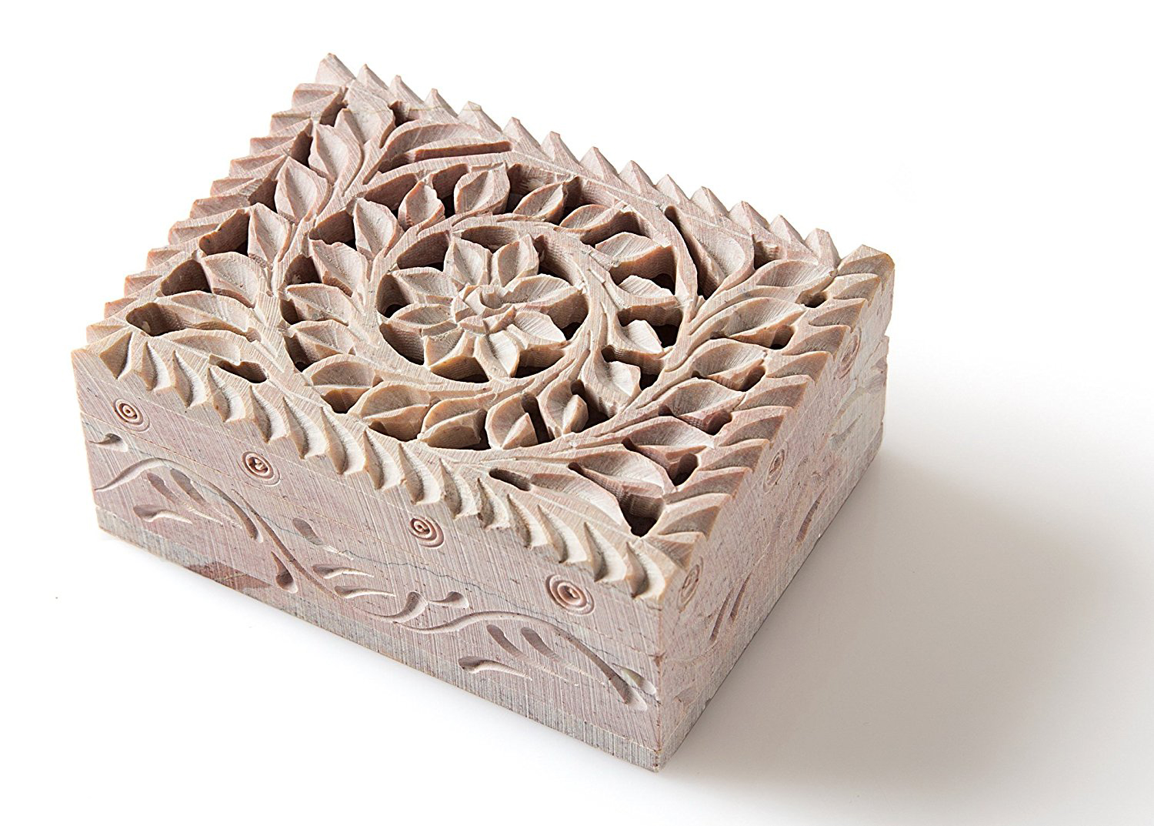
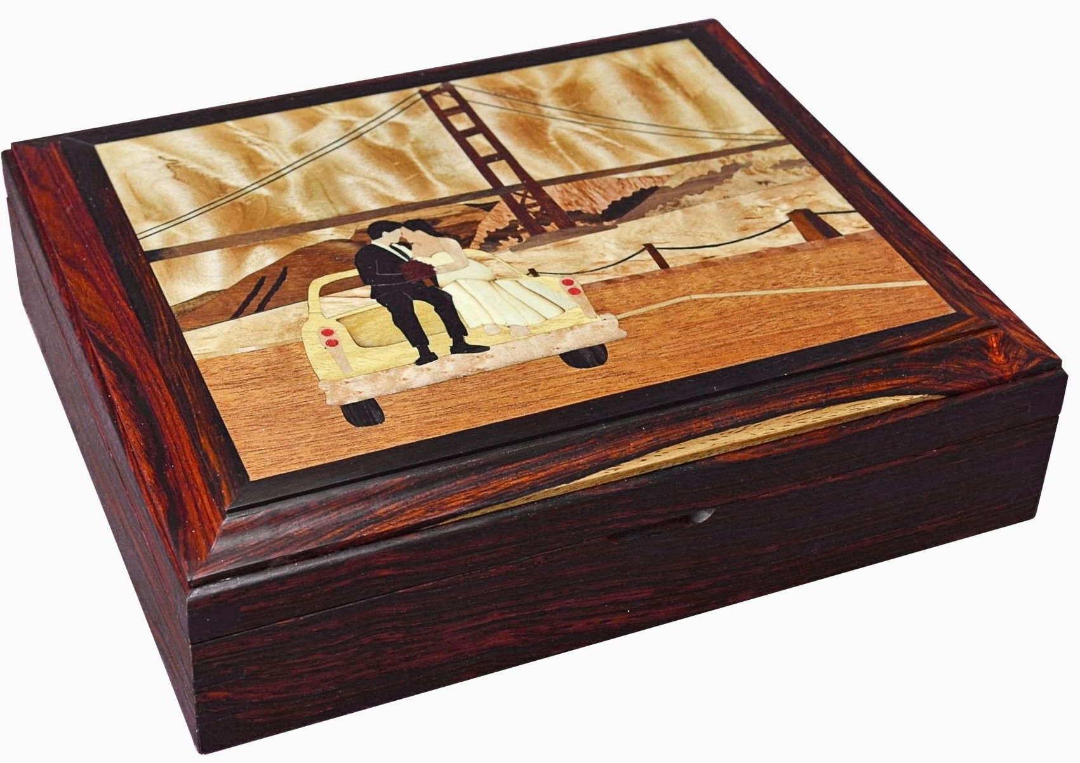
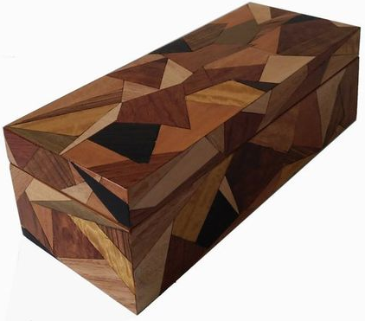
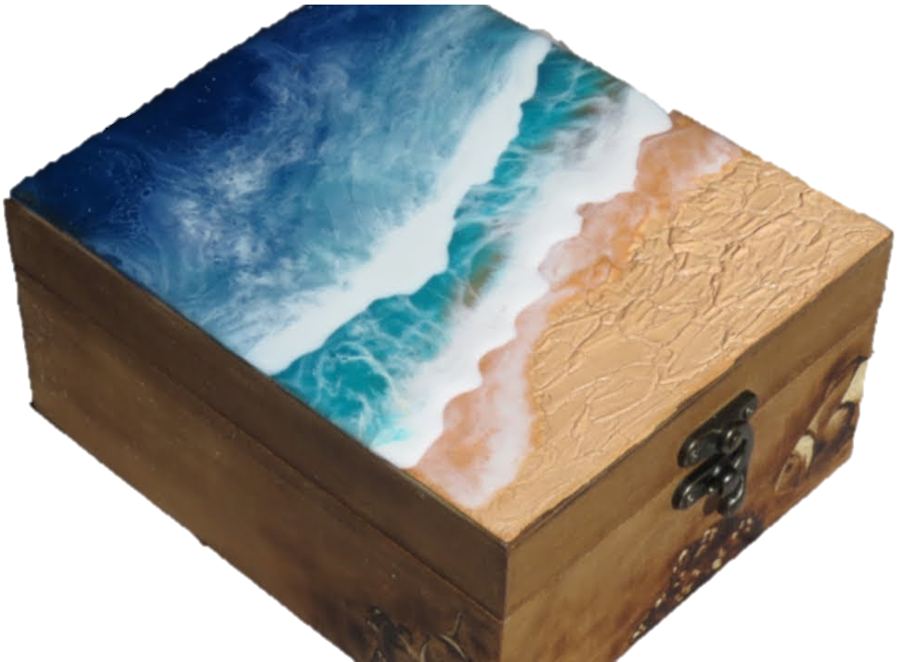
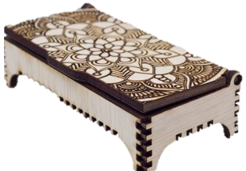
2024 Conference
Pencil Box Challenge
Let us know if teachers from your school will be competing before the 20th October 2024 by emailing :
admin@iiate.asn.au
The Challenge:
Build a pencil box! Not one that your students would make from Radiata Pine like the one on the left, but one that showcases any and all of your fine woodworking skills. There are many different ways to get creative and make this a an intricate/beautiful job. See back page for more details.
Contestants have up until the first day of the conference to build a Pencil Box which showcases their skill in the workshop.
Contestants may use any material they like. The size of the pencil box to be no larger than:
300 x 150 x 100
There will be a silent vote on the day to determine the winner. The victor will receive a prize for their school. Get creative! After the conference you will have an amazing Pencil Box you can show to your juniors to get them excited about woodwork and have many photos of other boxes you can show them to showcase new skills and techniques!
Some inspirational ideas for your Pencil Box:

Slide 2
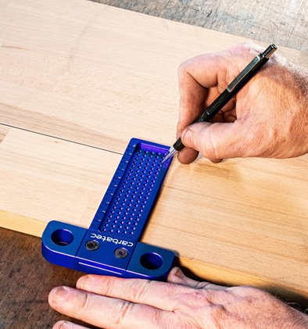
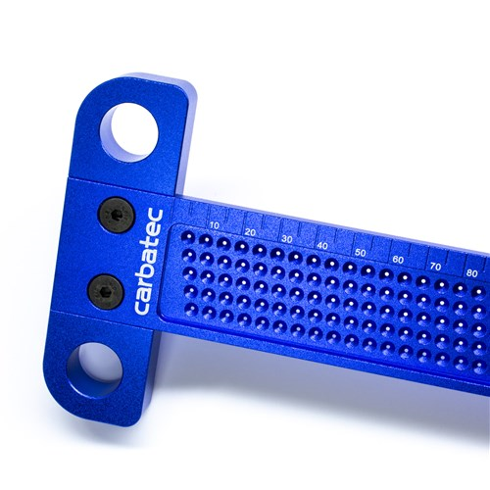
2024 Conference
Pencil Box Challenge
Let us know if teachers from your school will be competing before the 20th October 2024 by emailing :
admin@iiate.asn.au
Ideas of Skills to Incorporate:
Marquetry
Pyrography
Laser Engraving
Carving
Complex Joinery
Inlay
Parquetry/Intarsia
Interior Dividers
Felting
Resin Infill
To make this an exciting competition, the rules and prizes are as follows:
Looking at the list above, there are lots of different techniques and skills you could apply to your Pencil Box. The key to doing well is doing something you are passionate about. The goal is to produce the best piece of woodwork you can, within a 300 x 150 x 100 size envelope. When the 2024 conference rolls around, they will all be displayed in the auditorium anonymously, and everyone will have the opportunity to vote on which they think is the best. Whichever Pencil Box receives the most votes will be taking home to their school:
1st Prize
x24
Class set of easy mark Try Squares
courtesy of Carbetec!

